Slide 1
1
Managers and
Management
1-2

Slide 2
Learning Outcomes
Tell who managers are and where they work.
Define management.
Describe what managers do.
Explain why it’s important to study management.
Describe the factors that are reshaping and redefining management.
Copyright ©2017 Pearson Education, Inc.
1-<number>
Notes:
After studying this chapter, you will be able to:
Tell who managers are and where they work.
Define management.
Describe what managers do.
Explain why it’s important to study management.
Describe the factors that are reshaping and redefining management.

Slide 3
1-1
Tell who managers
are and where they
work.
Copyright ©2017 Pearson Education, Inc.
1-<number>

Slide 4
Who Are Managers?
Where Do They Work?
Organization
  A deliberate arrangement of people brought together to accomplish a specific purpose
Common Characteristics of Organizations
  Goals
  People
  Structure
Copyright ©2017 Pearson Education, Inc.
1-<number>
Notes:
Managers work in organizations, which we define as a deliberate arrangement of people brought together to accomplish a specific purpose.
Three characteristics that identify an organization are its:
Goals
People, and
Structure
Examples of organizations include:
Your neighborhood convenience store
The Dallas Cowboys football team
Fraternities and sororities
The Cleveland Clinic
Global companies such as Nokia

Slide 5
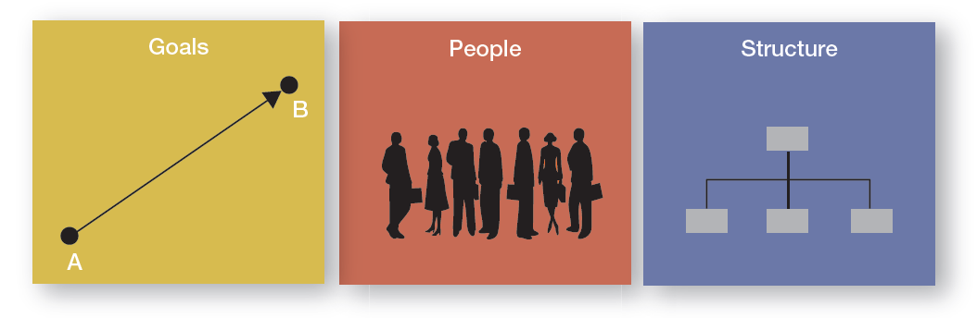
Three Characteristics of Organizations
Copyright ©2017 Pearson Education, Inc.
1-<number>
Notes:
Here we see the three common characteristics that organizations share:
Goals, which express the distinct purpose of a particular organization
People, who make decisions and engage in work activities to reach the organization’s goals, and
A deliberate structure, which systematically defines and limits its members’ behavior.

Slide 6
How Are Managers Different from Nonmanagerial Employees?
Nonmanagerial Employees
  Work directly on tasks
  Not responsible for overseeing others’ work
Managers
  Direct and oversee the activities of others
  May have work duties not related to overseeing others
Copyright ©2017 Pearson Education, Inc.
1-<number>
Notes:
Members of an organization can be divided into two categories:
Nonmanagerial employees work directly on a task and do not oversee the work of others. Examples include a cashier in a department store or someone who processes your course registration at the registrar's office. They may be called associates, team members, or contributors.
Managers, who direct and oversee the activities of the people in the organization. A manager’s job isn’t about personal achievement—it’s about helping others do their work. This distinction doesn’t mean, however, that managers don’t ever work directly on tasks.

Slide 7
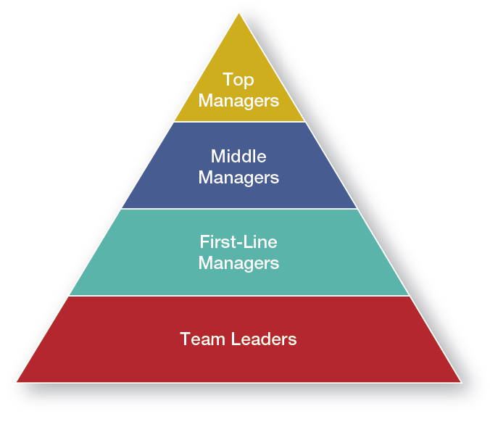
Management Levels
Copyright ©2017 Pearson Education, Inc.
1-<number>
Notes:
Managers in an organization can have a variety of titles. Managers are usually classified as top, middle, first-line, or team leaders.

Slide 8
What Titles Do Managers Have?
Top Managers
  Make decisions about the direction of an organization
Middle Managers
  Manage other managers
First-line Managers
  Direct nonmanagerial employees
Team Leaders
  Manage activities of a work team
Copyright ©2017 Pearson Education, Inc.
1-<number>
Notes:
Top managers are those at or near the top of an organization who make decisions about the direction of the organization and establish policies and philosophies that affect all organizational members. Titles include: president, vice president, chancellor, managing director, or chief executive officer.
Middle managers fall between the lowest and highest levels of the organization. They often manage other managers and sometimes nonmanagerial employees, and are responsible for translating the goals set by top managers into specific detailed tasks that lower-level managers oversee. Titles include: agency head, unit chief, division manager, or project leader.
First-line managers are responsible for directing the day-to-day activities of nonmanagerial employees. Titles include: supervisor, shift manager, or unit coordinator.
Team leaders are a special category of lower-level managers that have become more common as organizations have moved to using employee work teams to do work. They typically report to a first-line manager.

Slide 9
1-2
Define management.
Copyright ©2017 Pearson Education, Inc.
1-<number>

Slide 10
What Is Management?
The process of getting things done effectively and efficiently, with and through people.
Effectiveness: Doing the right things
Efficiency: Doing things right
Copyright ©2017 Pearson Education, Inc.
1-<number>
Notes:
Management is the process of getting things done effectively and efficiently, with and through people.
Efficiency and effectiveness have to do with the work being done and how it’s being done. Efficiency means doing a task correctly (“doing things right”) and getting the most output from the least amount of inputs. It’s not enough, however, just to be efficient. Managers are also concerned with completing
activities. In management terms, we call this effectiveness. Effectiveness means “doing the right things” by doing those work tasks that help the organization reach its goals.

Slide 11
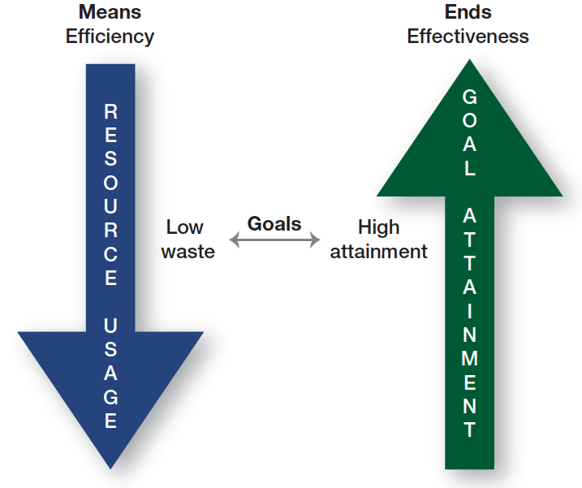
Efficiency and Effectiveness
Copyright ©2017 Pearson Education, Inc.
1-<number>
Notes:
As illustrated here, while efficiency is concerned with the means of getting things done, effectiveness is concerned with the ends, or attainment of organizational goals.
The concepts are different, but interrelated. It’s easier to be effective if you ignore efficiency. Poor management is often due to both inefficiency and ineffectiveness OR effectiveness achieved without regard for efficiency.
Good management is concerned with both attaining goals (effectiveness) and doing so as efficiently as possible.

Slide 12
Is the Manager’s Job Universal?
  Level in the Organization
  Size of the Organization
  Profit vs. Not-for-profit
  National Borders
Copyright ©2017 Pearson Education, Inc.
1-<number>
Notes:
Until now, we’ve looked at management as a generic activity. If management is truly a generic discipline, then what a manager does should be essentially the same whether he or she is a top-level executive or a first-line supervisor, in a business firm or a government agency; in a large corporation or a small business; or located in Paris, Texas, or Paris, France. In reality, a manager’s job varies depending on several factors.

Slide 13
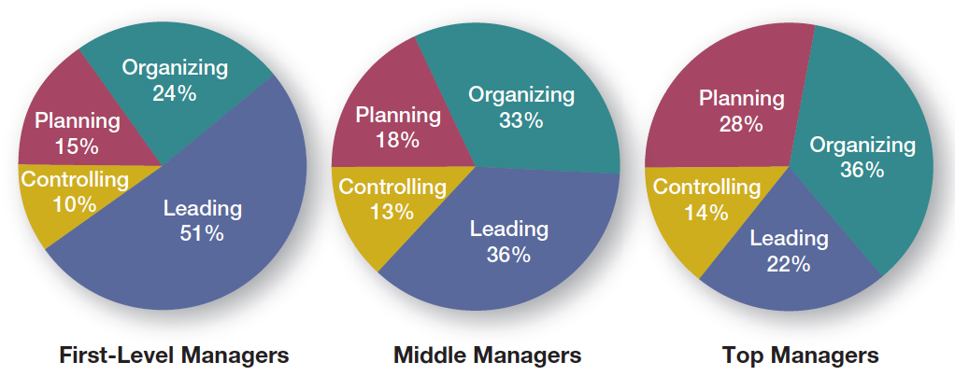
Is the Manager’s Job Universal?
1. Level in the Organization
Copyright ©2017 Pearson Education, Inc.
1-<number>
Notes:
First we’ll examine how a manager’s level in the organization impacts the role.
Although a supervisor and the CEO of a company may not do exactly the same things, it doesn’t mean that their jobs are inherently different. The differences are of degree and emphasis but not of activity. That is, the decisions of a top manager will have greater ramifications than those of a middle manager due to the content of the decision.
All managers regardless of level, make decisions and plan, lead, organize, and control. But the amount of time a manager gives to each activity is not necessarily constant. Also, the content of the managerial activities also changes with the manager’s level. The figure illustrates this variability.

Slide 14
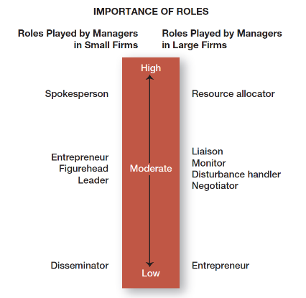
Is the Manager’s Job Universal?
2. Size of the Organization
Copyright ©2017 Pearson Education, Inc.
1-<number>
Notes:
As we see in this figure, managerial roles in small and large businesses differ.
For the purposes of our discussion, a small business is an independent business having fewer than 500 employees that doesn’t necessarily engage in any new or innovative practices and has relatively little impact on its industry.
The most important role of a small business manager is that of spokesperson, performing externally in meeting with customers, arranging financing with bankers, searching for new opportunities, and stimulating change.
The actions of a manager in a large organization, however, are directed internally, deciding which organizational units get which and how much of the available resources.
A small business manager is more likely to be a generalist in a less formal, less structured, and less complex environment than his counterpart in a large organization.
Again, as with organizational level, we see differences in degree and emphasis but not in the activities that managers do. Managers in both small and large organizations perform essentially the same activities, but how they go about those activities and the proportion of time they spend on each are different.

Slide 15
Is the Manager’s Job Universal?
Profit vs. Not-for-profit
National Borders
Copyright ©2017 Pearson Education, Inc.
1-<number>
Notes:
The most important difference between the two is how performance is measured. Profit, or the “bottom line,” is an unambiguous measure of a business organization’s effectiveness. Not-for-profit organizations don’t have such a universal measure, making performance measurement more difficult. But even not-for-profit organizations need to make money to continue operating.
If management concepts were transferable across countries, they would apply universally in all parts of the world. However, research shows that while concepts transfer easily among many English-speaking countries, management concepts will likely need to be modified when dealing with India, China, Chile, or other countries with economic, political, social, or cultural environments that differ from those of the so-called free-market democracies.

Slide 16
1-3
Describe what managers do.
Copyright ©2017 Pearson Education, Inc.
1-<number>

Slide 17
What Do Managers Do?
Ways to Look at What Managers Do
  Four Functions Approach
  Management Roles Approach
  Skills and Competencies
Copyright ©2017 Pearson Education, Inc.
1-<number>
Notes:
No two organizations are alike, and neither are managers’ jobs. But managers’ jobs do share some common elements. We’ll discuss three approaches to describing what managers do.

Slide 18
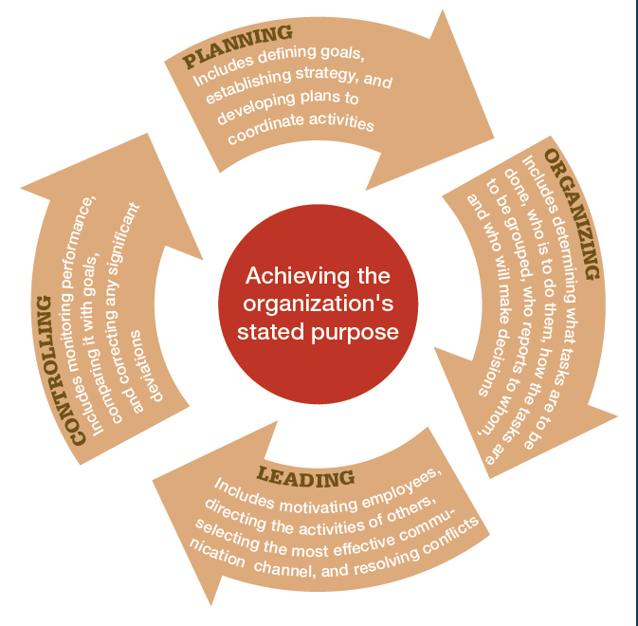
Four Functions Approach
Planning
Organizing
Leading
Controlling
Copyright ©2017 Pearson Education, Inc.
1-<number>
Notes:
Managers perform certain activities, tasks, or functions as they direct and oversee others’ work. This approach was first proposed by French Industrialist Henri Fayol. He said managers engaged in five management activities: plan, organize, command, coordinate, and control (POCCC). His choice of these five functions was based on his own observations of the mining industry, not from a formal survey. Today, those management functions have been condensed to the following four:
Planning includes defining goals, establishing strategy, and developing plans to coordinate activities.
Organizing includes determining which tasks need to be done and by whom, how tasks are to be grouped, who reports to whom, and who will make decisions.
Leading includes motivating employees, selecting the most effective communication channel, and resolving conflicts.
Controlling includes monitoring performance, comparing it with goals, and correcting any significant deviations.

Slide 19
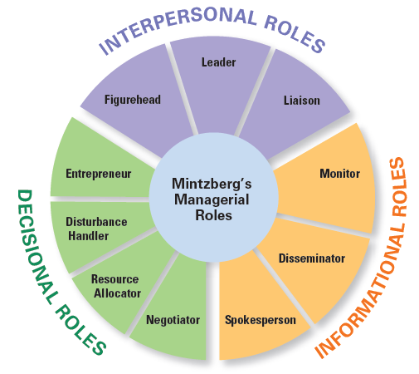
Management Roles Approach
Copyright ©2017 Pearson Education, Inc.
1-<number>
Notes:
In the late 1960s, Henry Mintzberg dispelled long-held notions that managers were reflective thinkers who carefully processed information before making decisions. His empirical study of 5 chief executives showed that managers perform ten different but highly interrelated roles. He categorized these actions around the following three general categories:
Interpersonal relationships: Figurehead, leader, and liaison.
Informational transfer: Monitor, disseminator, and spokesperson.
Decision-making: Entrepreneur, disturbance handler, resource allocator, and negotiator.

Slide 20
Which Approach Takes the Prize?
Functions ☑
Roles ☐
Copyright ©2017 Pearson Education, Inc.
1-<number>
Notes:
Both approaches seem to do a good job of describing what managers do. But, the functions approach wins! Its clarity and simplicity in describing what managers do make it continually popular.
But, don’t ignore Mintzberg’s roles approach; it does offer another way to describe what managers do.

Slide 21


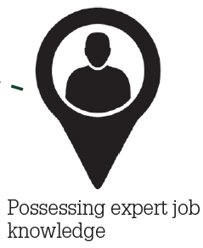

What Skills Do
Managers Need?
Conceptual Skills
Interpersonal Skills
Technical Skills
Political Skills
Source: Simon/Fotolia
Copyright ©2017 Pearson Education, Inc.
1-<number>
Notes:
Another way to describe what managers do is by looking at the skills they need for managing. Management researcher Robert L. Katz and others describe four critical skills:
Conceptual skills: Analyzing and diagnosing complex situations to see how things fit together and to facilitate making good decisions.
Interpersonal skills: Working well with other people both individually and in groups by communicating, motivating, mentoring, and delegating.
Technical skills: Job-specific knowledge, expertise, and techniques needed to perform work tasks. (For top-level managers − knowledge of the industry and a general understanding of the organization’s processes and products; For middle- and lower-level managers − specialized knowledge required in the areas where they work—finance, human resources, marketing, computer systems, manufacturing, information technology).
Political skills: Building a power base and establishing the right connections so they can get needed resources for their groups.

Slide 22
1-4
Explain why it’s important to study management.
Copyright ©2017 Pearson Education, Inc.
1-<number>

Slide 23
Why Study Management?
We all have a vested interest in improving how organizations are managed.
Copyright ©2017 Pearson Education, Inc.
1-<number>
Notes:
Why? Because we interact with them every day of our lives and an understanding of management offers insights into many organizational aspects. Understanding management offers insights into why some companies get our orders right the first time, why once-thriving organizations no longer exist, and which companies continue to prosper during challenging economic times.
Studying management provides knowledge about manager skills and responsibilities, how organizations function, and how people behave in the workplace.

Slide 24
Why Study Management?
Most people will either manage or be managed.
Copyright ©2017 Pearson Education, Inc.
1-<number>
Notes:
If you plan to be a manager, you’ll form a foundation on which to build your management skills and abilities. Even if you don’t see yourself managing, you’re still likely to have to work with managers. And the reality is, that if you plan to work for a living, you’ll probably have some managerial responsibilities even if you’re not a manager. Studying management provides knowledge about managerial skills and responsibilities, how organizations function, and how people behave in the workplace.

Slide 25
1-5
Describe the factors that are reshaping and redefining management.
Copyright ©2017 Pearson Education, Inc.
1-<number>

Slide 26
Welcome to the New World of Management!
Changing Workplaces + Changing Workforce
Copyright ©2017 Pearson Education, Inc.
1-<number>
Notes:
Managers today are dealing with changing workplaces, a changing workforce, global economic and political uncertainties, and changing technology. Distributed labor companies are changing the face of temporary work. Some 30-45 percent of the world’s work force works from home or are virtual employees. More and more businesses are relying on apps and mobile-enhanced Websites to run their businesses.
Managers everywhere are likely to have to manage in changing circumstances, which means that how managers manage is changing. We will now look at four specific changes that are increasingly important to organizations and managers everywhere: customers, innovation, social media, and sustainability.

Slide 27
Why Are Customers Important?
Consistent, high-quality customer service is essential to survival.
Copyright ©2017 Pearson Education, Inc.
1-<number>
Notes:
Organizations depend on their customers to exist in the marketplace. Until recently, customer focus was thought to be the responsibility of marketing, but organizations are now discovering that employee attitudes and behaviors play a big role in customer satisfaction.
Managers are recognizing that delivering consistent high-quality customer service is essential for survival and success in today’s competitive environment. They recognize that employees are an integral part of creating a customer-responsive organization where employees are friendly, courteous, accessible, knowledgeable, prompt in responding to customer needs, and willing to do what’s necessary to please the customer.

Slide 28
Why Is Innovation Important?
“Nothing is more risky than not innovating.”
Copyright ©2017 Pearson Education, Inc.
1-<number>
Notes:
Innovation means doing things differently, exploring new territory, and taking risks.
In today’s challenging environment, innovation is critical and managers need to understand what, when, where, how, and why innovation can be fostered and encouraged throughout an organization. Managers need to be personally innovative and to encourage their employees to be innovative.

Slide 29
Importance of Social Media
Connecting with customers
Managing human resources
Copyright ©2017 Pearson Education, Inc.
1-<number>
Notes:
More than a billion people use social media platforms like Facebook, Twitter, YouTube, LinkedIn, etc. Managers need to understand and manage the power of social media, because employees use them for both personal and work purposes. More and more businesses are turning to social media not just as a way to connect with customers but also as a way to manage their human resources and tap into their innovation and talent. But it’s not without its perils. Managers need to remember that social media is a tool that needs to be managed to be beneficial.

Slide 30
Importance of Sustainability
Integrating economic, environmental, and social opportunities into business strategies.
Copyright ©2017 Pearson Education, Inc.
1-<number>
Notes:
Another twenty-first century challenge is managing in a sustainable way. This means not just managing efficiently and effectively, but also responding strategically to environmental and societal challenges. Sustainability can be defined as meeting the needs of people today without compromising the ability of future generations to meet their own needs. From a business perspective, sustainability refers to a company’s ability to achieve its business goals and increase long-term shareholder value by integrating economic, environmental, and social opportunities into its business strategies.

Slide 31
Managers Matter!
Employee productivity, loyalty, and engagement hinge on employee/manager relationships.
Copyright ©2017 Pearson Education, Inc.
1-<number>
Notes:
The Gallup Organization, which has polled millions of employees and tens of thousands of managers, has found that the single most important variable in employee productivity and loyalty isn’t pay or benefits or workplace environment; it’s the quality of the relationship between employees and their direct supervisors.
Gallup also found that the relationship with their manager is the largest factor in employee engagement —which is when employees are connected to, satisfied with, and enthusiastic about their jobs—accounting for at least 70 percent of an employee’s level of engagement.

